Slide 1
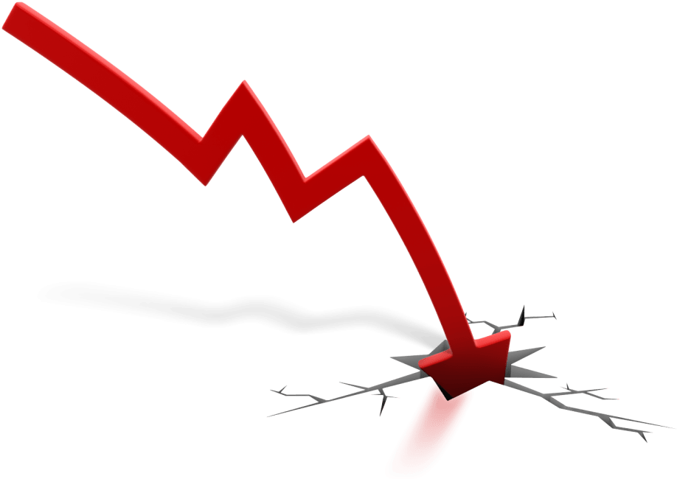
Risk Management during the 2008 Crisis
Presentation by:
Reba Maria Thomas
Jiachen Zheng
Xiaoyan Tang

Slide 2

Timeline of events
Lowering of Interest Rates
House Prices went up
Subprime Loans
Mortgage Backed Securities or CDO s
Increase in Interest Rates
House Prices started going down
Lenders started filing for Bankruptcy
Stock Prices started to fall

Slide 3
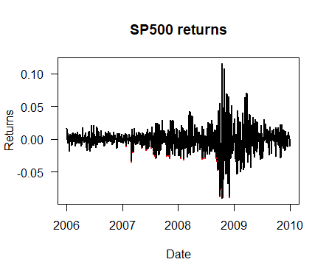
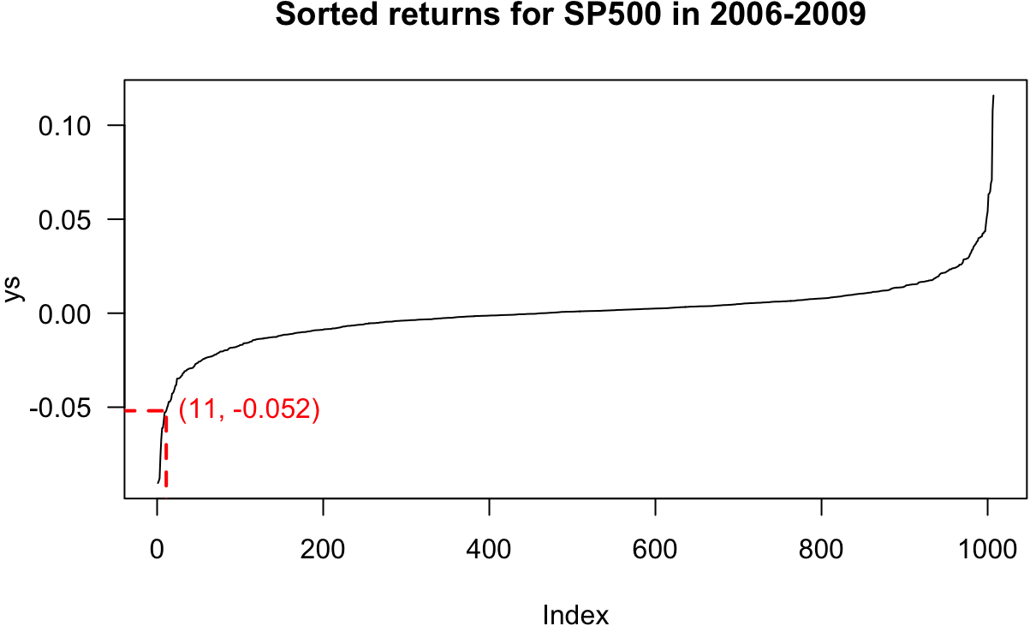
Risk Measures
Volatility
Value at Risk (VaR)
A measure that helps us understand how risky an investment is.
Higher the volatility, riskier the investment.
A statistic that measures how much money could be lost by an investment over a certain period of time.
Calculated VaR at 99% is 52%.
VaR is not ideal for Highly Volatile conditions

Slide 4
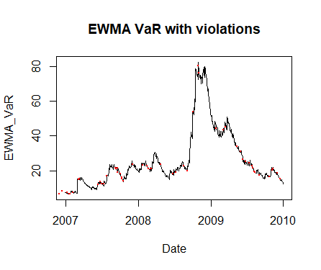
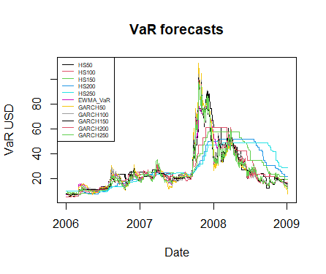
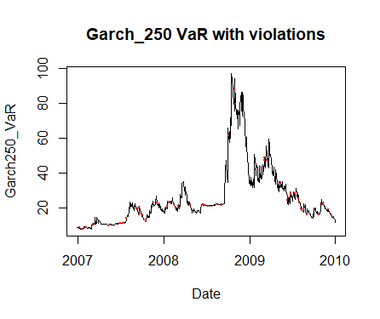
Calculating VaR using different Methods

Slide 5
VaR vs. ES
Losses
VaR calculates only the percentages of losses that exceeds the probability
ES calculates the magnitude of losses
Subadditivity
VaR violates this property and the diversification effect
Complexity
VaR is easier and less complex
ES is more difficult to estimate and larger sample size is required
ES follows this property
Expected Shortfall (ES)
A risk measure that quantifies the amount of losses in an investment portfolio.
Calculated ES at 97.5% is 53%.
ES^{97.5%} has been used by the BASEL III standards

Slide 6
“The Big Short”
What is Shorting?
It is an investment strategy which investors use for stocks that they believe would decrease in value in the future. They bet on the decline in the stock price.
How does Shorting work?
Investors borrows a security and sells it and then buy it back later for less.
Investors who made money during the Financial Crisis through Shorting:
John Paulson
Micheal Burry
Steve Eisman

